Slide 1
Lesson 1 Introduction to Enterprise Networks

Slide 2
Course Layout – Hacking 300
Lesson 1 – Introduction to Enterprise Networks Lesson 2 – Windows Domains and Active Directory Lesson 3 - Linux Networks
Lesson 4 – Kerberos Fundamentals
Lesson 5 – Attacking Domain Environments
Lesson 6 – CTF Start Lesson 7 – CTF Q&A
Lesson 8 – CTF Q&A Lesson 9 – CTF Q&A
Lesson 10 - Outbrief and Course Conclusion
← Today
Real-world systems: ethical hacking practicum – UW Summer 2021

Slide 3
What to Expect?
Course 330 Content | Purpose?
Lesson 1 – Introduction to Enterprise Networks Lesson 2 – Windows Domains and Active Directory Lesson 3 – Linux Networks Lesson 4 – Kerberos Fundamentals Lesson 5 – Attacking Domain Environments | For techniques such as “pass the hash” and related, Lessons 1-4 are the Where does this show up What, why, and how of the problem Lesson 5 is a high level overview of Red Team processes and strategy
Keep in mind we had to choose where to spend our time (setting the right expectations):
Area | Time Allocated | Skills/Value Gained
basic security topics shared among areas | 20% | Enough to understand more advanced topics
pentesting & application security | 50% | Test basic applications independently + understand how to grow
red teaming & Network+OpSec | 10% | Awareness of common problems and techniques
various other security disciplines and topics | 10% | Awareness and hands on introduction
nontechnical topics such as report, process, value | 10% | Write basic reports + awareness of other for other considerations
Notes:
This by no means will make you a Red Team expert. Honestly if red teaming is your passion, you should find a way to learn about it that is focused specifically on it. For example, we touched upon reverse engineering, buy by no means does it make you a RE expert or even proficient.
- Hacking 100 was a introduction to a little bit of everything
- Hacking 200 was advanced “pentesting” and application security techniques and concepts
- Hacking 300 is a intro to “Red Teaming” and related concepts

Slide 4
Clarity: Red Teaming Vs. Pentesting
Red Teaming
Goals: Show Impact - How bad can it get? Depth of Risk
Characteristics New Issues typically identified in network and operational designs Okay to reuse known issues to prove a point about risk
Value to Business Provide clarity on prioritization of what problems to fix first – “how bad is it”
Pentesting
Goals Obtain Coverage - What can go wrong? Areas of Risk
Characteristics New Issues typically identified in application and systems designs Point is to identify new issues to describe the overall risk
Value to Business Provide visibility into the state of the security posture of an application or system – “what could go wrong”
Naturally, there are grey areas, overlap, disagreements, etc Also other disciplines of security such as researcher, analyst, forensic, blue team, etc

Slide 5
Review – What makes a “good” pentester?
Depends whom you talk to
Depends on what specific discipline
For our purposes we mean loosely application security and related fields
Mindset - Strong attacker's mindset
Perseverance – Ability to tread into the unknown and make sense of things
Knowledge - Strong foundational knowledge of “everything”
Threat Modeling - Great at threat modeling, quickly consume and digest designs
Notes:
Mindset - Strong attacker's mindset
Need to be able to appropriately question all things
Always be asking why and how
Does not mean “never trust”, but with more experience develop an appropriate bar or what is assumptions vs reality (comment on personal experience: e.g: found bugs in .net)
Always things of problems from multiple angles and points of view
How can I abuse this?
Who cares and does not care?
What can be added to the equation to change its outcome?
Perseverance – Ability to tread into the unknown and make sense of things
Be able to “just figure it out”
what happens when you have to test something not seen before?
Use experience to relate to things/concepts you know and to figure out when your knowledge stops
Use experience to form a strategy to understanding the end to end of everything
Most importantly, being comfortable with being uncomfortable
Knowledge - Strong foundational knowledge of “everything”
It is important to be able to recognize what you are looking at
Know if a attack will work in certain scenarios or not others, same for solutions
All it takes is one small thing to fall our of place for things to go wrong, you need to understand all small things.
Investing into fundamental understandings is one of those things that sets apart the more jr from the more senior folks in specifically ability.
The ones finding the vulns everyone else copies or builds their tools off of, they all got there through a fundamental understanding of how “everything” works
What do I mean by everything? OS, network, protocols, computers, internet, expectations, etc etc
Of course there are specializations and sme, but not a excuse for skipping over atleast a basic understanding of how everything fits together
Of course not one can know “everything”, but the point is you strive for it and security is a lifelong profession of always always always learning. Sometimes reading, sometimes experimenting, always learning.
Threat Modeling - Great at threat modeling, quickly consume and digest designs
Directly tied into proficiency in finding both a good spread and depth of issues
You don’t find significant issues by blindly pounding on a application.
Even with fuzzing there is “smart” and “dumb” fuzzing, and pentesting is not fuzzing
Need to be able to quickly understand designs and security contracts (intent/expectations)
Need to be able to follow, mentally, from start to finish of what happens to the data and what happens in the application.
Use experience and knowledge to fill in gaps
Basically come up with a mental strategy for a attack plan for places that are more or less vulnerable
Be able to mentally and quickly reason out what is a good or bad use of time
Come up with a variety of ideas to try out
Have “some” kind of idea of how to go about attacking the application simply based on design

Slide 6
Demo + Closing out Pentesting
Quick (10 min or so) Demonstration of how I would setup and approach a “pentest” from scratch
Attack Plan
Thought process (coverage)
Skills necessary, attacker's mindset, etc
Initially start to look at things
Make sure to
Pay attention to how I am applying everything we have learned so far
Keep in mind what pentesting “looks like”
Distinguish between red team vs pentesting
Think critically here, when does a business/client need red teaming vs pentesting
See the areas of overlap
Demo is completely unplanned and organic, pay attention to what parts are universal and consistent
Someone pick something!!!
Anything that we can start looking at as a proof of concept, preferably that has a bug bounty, so we are not violating laws
Notes:
Try to keep the demo to about 10 minutes

Slide 7
Enterprise Networks
Wide range of systems that enable collaboration in a corporate environment
Core Infrastructure
Hardware
Software and Services - this will be our focus
Processes and
Humans

Slide 8
Example:
http://ventej.blogspot.in/2012/06/typical-corporate-network-diagram.html

Slide 9
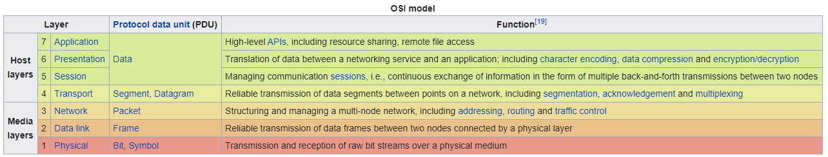
The Network
Layer | Description
7 – Application | Communicating with Application/program - aka “abstraction” layer – being able to send a “request”, simply shipping a package without worrying about what it takes to make that happen. Not application logic, just communication. e.g: HTTP, FTP, Telnet, DHCP, etc
6 – Presentation | Translate/transform data so the application layer understands – aka “syntax” layer e.g: ASCII, Serialization, character encoding, etc
5 – Session | How to manage a session, not just send data but have a conversation – special rules/methods for connecting e.g: pptp, SOCKS, RTP, SSH, DNS, HTTP, etc
4 – Transport | How “structured” data is transferred, variable-length data sequences e.g: TCP, UDP, etc
3 – Network | How to interact with multiple nodes - routing protocols, network-layer address assignment e.g: ipv4, ipv6, icmp, ipsec, etc
2 – Data link | Protocol/How to handle raw bits, protocol for flow control of 1 node to 1 node e.g: 802.3 Ethernet, 802.11 Wi-Fi, and 802.15.4 ZigBee
1 – Physical | Electrical Connection - raw bit streams over a physical medium e.g: Bluetooth, Ethernet, USB, etc

Slide 10
Infrastructure of an Enterprise Network
Buildings, Datacenters, Doors,..
Wide range of devices
Desktops, Tablets, Phones
BYOD – Bring Your Own Device
Appliances
Connectivity
Wiring
Wi-Fi
Cell phones
Routers
Switches

Slide 11
Software and Services in an Enterprise Network
Enterprise directory
DNS servers
File and print servers
Database systems and big data services
Email systems and collaboration suites
Web servers, CRM systems, custom apps
Public Key Infrastructure
Remote Access Services

Slide 12
Enterprise Directory
Contains metadata of objects of all the resources of an organization in one place. This includes domains, machines, servers, services, user accounts, etc.
Also manages security and policies centrally.
Products: Active Directory
Protocols: LDAP
Interesting TCP/UDP Ports: 389, 636, 3268, 3269
Great place for reconnaissance
Lesson 2 will dive into all the details of Active Directory

Slide 13

Enterprise Directory – Hacker’s View
Helpful tools to look into
Oldies
https://github.com/PowerShellMafia/PowerSploit
https://github.com/EmpireProject/Empire
Still maintained
https://github.com/cobbr/Covenant
https://github.com/BloodHoundAD/BloodHound

Slide 14
DNS Servers
Domain Name Servers enable the resolution of DNS names to IP addresses
E.g. www.washington.edu => 1.2.3.4
Insecure (DNSSEC is not widely used yet)
https://blog.apnic.net/2020/03/02/dnssec-validation-revisited/
Code shouldn’t trust the response of a DNS server
Products: BIND
Protocols: LDAP, DNS
Interesting TCP Ports: 53

Slide 15
DNS Servers – Hacker’s View
Severe issues have been found in BIND in the past
https://kb.isc.org/article/AA-00913/0/BIND-9-Security-Vulnerability-Matrix.html
DNS spoofing
Since applications shouldn’t trust DNS, if there is a lack of transport layer security becoming a MITM via DNS attacks can allow Elevation of Privilege.
DNS cache poisoning
https://youtu.be/1d1tUefYn4U?t=7
https://youtu.be/5CUG7isl8Ew
Tools
https://github.com/aboul3la/Sublist3r - enum subdomains

Slide 16
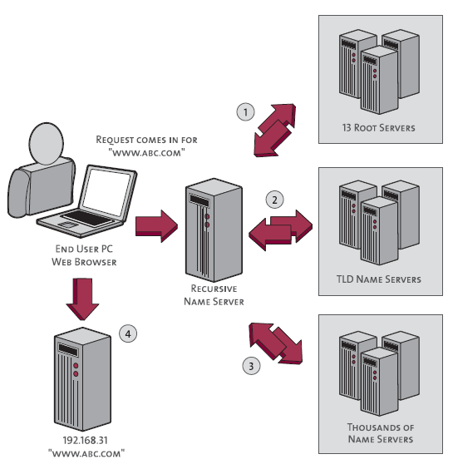
DNS Servers – What Actually Happens?
More Simply
Ask the internet police who are the record keepers ⏎
Ask the record keepers/registry for the records for the respective domain ⏎
Ask another server specified in the domain records for the IP address which should be used ⏎
connect to that IP address
More Technical
Query the Internet root servers.
This is for example verisign, icann, etc - https://www.iana.org/domains/root/servers
These are servers around the world that everyone simply trusts as a word of truth
They tell us what TLD nameserver to connect to for a given domain name which is managed
Query the TLD name servers (Top-Level Domain name servers)
TLD name server keeps tracks of details related to a domains, specific TLD are responsible for domain names based on extension, such as ".com", ".net", etc. TLD nameservers are managed by the Internet Assigned Numbers Authority (IANA), part of ICANN
Since the TLD nameserver keeps track of details related to a domain, we ask it what authoritative nameserver should be used for the domain being looked up.
Query the DNS/authoritative name servers
A authoritative name server is a name server that gives answers in response to questions asked about names in a zone. An authoritative name server provides actual answer to your DNS queries, such as what IP address for a respective name.
It will return the actual IP address which should be connected to for a specific name.
Connect to specific IP address
we actually connect to the IP address
Notes:
DNS in short is a Domain Name System. Its purpose is to convert domain names, such as “test.com", into IP addresses such as "1.2.3.4".
This lookup of what IP address to connect to happens for every single attempt to connect to a hostname or a domain name, it could be in batches or cached or per attempt.
Without it "connecting to a website" would not work, network communication is ultimately accomplished by finding and talking to IP addresses. We connect to IP addresses, not domain names. We lookup domain names to get IP addresses, to then connect to IP addresses. However DNS is just one part of what happens when you "connect" to a website, "finding a server on the internet" has multiple steps. This is important to understand as it helps to explain why you can't trust all DNS servers or why when you connect to a website, it can maliciously and arbitrarily tell you what IP to connect to.

Slide 17
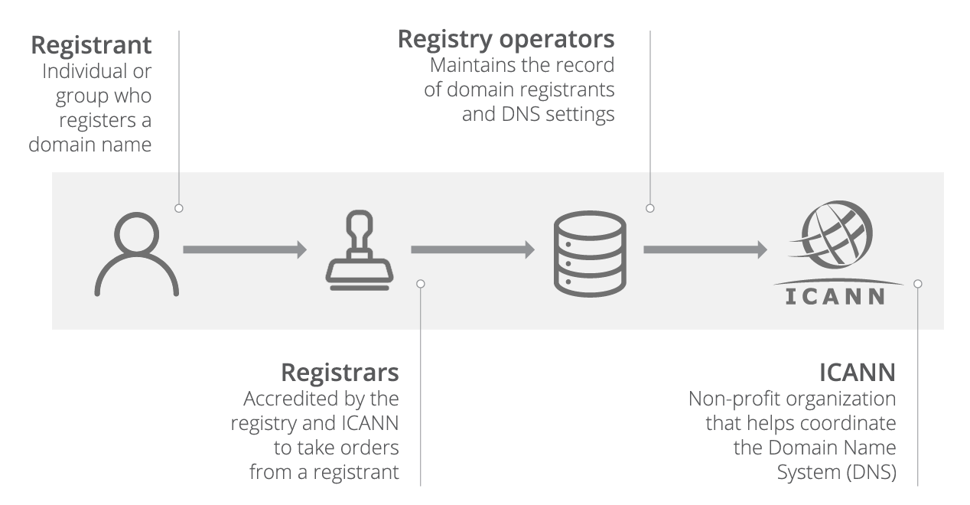
DNS Servers – What Actually Happens?
Registrar and Registry
Registrar: is an accredited organization, like GoDaddy, that sells domain names to the public
Registry: domain name registry is an organization that manages top-level domain names.
You can "buy" domains: you can go to a company/organization/registrar like godaddy to "buy a domain".
You can Host your own DNS server for the domain record: Once in control of the domain record, you can update it to point at a DNS server which you control. For an attacker this means when people connect to "attacker.com", they ask the registry for the record, the record says use the attacker's DNS server, and that server can return back any IP address it wants. This nature of issue typically shows up as “DNS Rebinding” attacks
(image stolen from cloudflare.com)
Notes:
Registrar and Registry
Registrar: is an accredited organization, like GoDaddy, that sells domain names to the public. Some have the ability to sell top-level domain names (TLDs) like .com, .net and .org, or country-code top-level domain names (ccTLDs) such as .us, .ca and .eu.
Registry: domain name registry is an organization that manages top-level domain names. They create domain name extensions, set the rules for that domain name, and work with registrars to sell domain names to the public. For example, VeriSign manages the registration of .com domain names and their domain name system (DNS). (definition from https://www.godaddy.com/help/what-is-the-difference-between-a-registry-registrar-and-registrant-8039)
You can "buy" domains: What this tells us is that you can go to a company/organization/registrar like godaddy to "buy a domain". They will help you to update records maintained with a registry, servers on the internet that keep track of details related to a domain, to details of your choosing.
You can Host your own DNS server for the domain record: Once in control of the domain record, you can update it to point at a DNS server which you control. For an attacker this means when people connect to "attacker.com", they ask the registry for the record, the record says use the attacker's DNS server, and that server can return back any IP address it wants.
This is a good case study, it highlight you should thing about the end to end of everything.
E.g: can you trust your ISP? Can you trust your Domain Controller? And Your Domain controlled trust you? What is that trust made out of?
A domain controller (DC) is a server computer that responds to security authentication requests within a computer network domain. It is a network server that is responsible for allowing host access to domain resources. It authenticates users, stores user account information and enforces security policy for a domain.

Slide 18
File and Print Servers
File servers allow an organization to centrally store, back up, and share
data between employees.
Mini Exercise: What are some protocols and ports for filesharing? How would you go about interacting with it? Research if you don’t know.

Slide 19
File and Print Servers
File servers allow an organization to centrally store, back up, and share
data between employees.
Products: Linux, Windows Server
Protocols: SMB, Samba, CIFS,…
Interesting TCP Ports: 445,…

Slide 20
File and Print Servers – Hacker’s View
What to look for?
File servers
Weak ACLs on network shares
Reconnaissance: search for information, passwords, and other secrets
What if adversary has write permission?
Print servers
Vulnerable drivers: https://www.reddit.com/r/netsec/comments/es9gjb/local_privilege_escalation_in_man y_ricoh_printer/
Entry point to the network: https://security.berkeley.edu/education-awareness/best- practices-how-articles/system-application-security/network-printer-security

Slide 21
Email Systems
Many corporations run their own email systems to allow sending and receiving corporate mail and control who has access to the data.
It’s increasingly common that email is outsourced to a third-party cloud service solution.
Products: Microsoft Exchange Protocols: POP, IMAP, MAPI,… Interesting Ports: 110, …

Slide 22
Email Systems – Hacker’s View
Email systems handle very critical information and offer opportunities for attackers.
Gaining access to useful information
Spoofing: start of an effective phishing campaign
https://www.reddit.com/r/netsec/comments/6kvkqx/hack_defense_how_to_send_f ake_emails/
Email relaying attacks: https://en.wikipedia.org/wiki/Open_mail_relay
Unpatched systems
Past Issues: Melissa (mail macro worm), ILOVEYOU

Slide 23
SNMP – Network Management
The Simple Network Management Protocol is used to manage network infrastructure in a corporation.
Just know it exists
Protocols: SNMP
Ports: 162, 163

Slide 24
Web Servers
‘90s and earlier: static pages
Today: not just websites; full on application interfaces that enable IPC and RPC for massive distributed systems
Products
Apache, IIS, Nginx, etc
Web app frameworks:
Node, Flask, way too many to list
Protocols
HTTP, HTTPS, HTTP/2, WebSockets
Interesting ports:
- 80, 443 (8080,..)
Tools:
https://github.com/ffuf/ffuf - Popular fuzzer, but don’t blindly use it

Slide 25
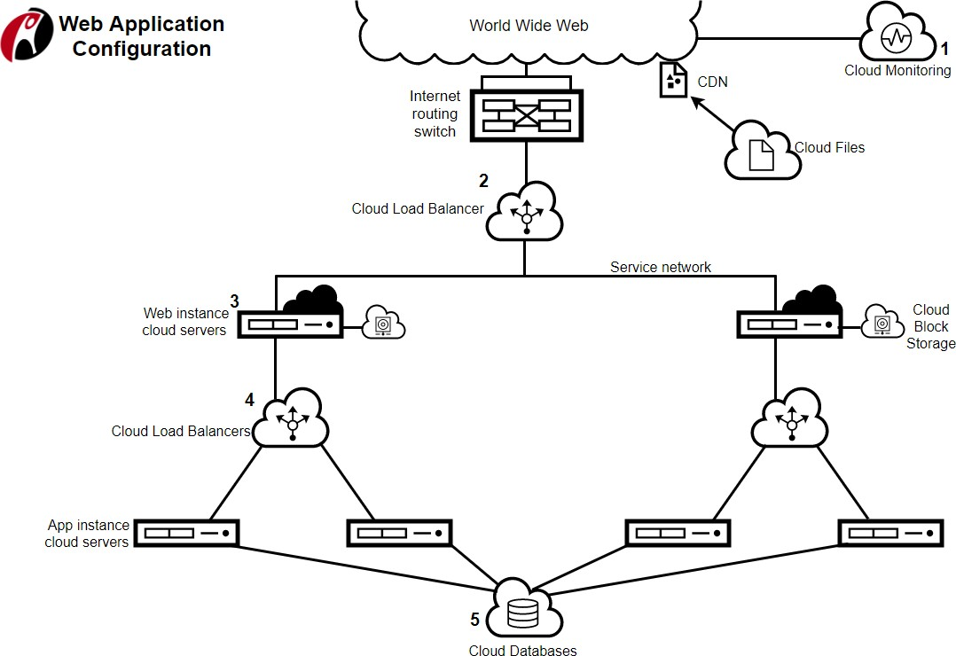
Web apps – 2013+
https://support.rackspace.com/how-to/rackspace-open-cloud-reference-architecture/

Slide 26
Web Servers – Hacker’s View
Web Servers and custom web applications are notorious for having some of the most critical flaws, from buffer overflows to authentication bypasses and many application level flaws you might discover a wide set of issues in web apps.
Past vulnerabilities: Nimda (most widespread worm within 22 minutes)
https://www.sans.org/security-resources/malwarefaq/32-nimda-exploit
Look for problems
At the program level – e.g. in Nginx itself
At the app level
In the frontend - cross-site scripting, cross-site request forgery
https://www.google.com/about/appsecurity/learning/xss/
https://www.veracode.com/security/xss, https://www.veracode.com/security/csrf
In the backend – find an API endpoint and fuzz it

Slide 27
Database Systems
Databases allow organizations to store information in a central place. The core features of a database system include the ACID properties (Atomic, Consistency, Integrity and Durability).
Mini Exercise:
What are some products, protocols, and ports that you know of?

Slide 28
Database Systems
Products
Oracle, SQL Server, MySQL, MongoDB,…
Protocols
TDS, ORA, REST,…
Interesting TCP Ports
1333, 1334,…, just go Google these. You only really memorize these when you work with them often enough.

Slide 29
Database Systems – Hacker’s View
Databases typically store data related to customers, sales, other critical business data, and in some cases, application state
Look for:
Weak (or nonexistent) authentication
Can find unauth’d mongo with shodan.io
Weak passwords
Insecure communication (not encrypted)
Unpatched systems
SQL Injections

Slide 30
Big Data Solutions
As discussed in the previous Course 200 – big data solutions, and non- relational systems are increasingly popular in order to scale out and bring the code closer to the data.
Example products: Apache Hadoop, HDInsight
Protocols used: HTTP (REST), HTTP/2 (gRPC), WebSockets
Interesting TCP Ports: 80/443

Slide 31
Big Data Solutions – Hacker’s View
See Course 200. But also,
- Look for misconfigurations
- If you have access to a database, can you view information that is not intended for you?

Slide 32
CRM Solutions
Customer Relationship Management products are an important service within an enterprise. They allow to keep track of customer information, contracts, etc..
Products: SAP, Dynamics, Salesforce,..
Protocols and Ports: REST, 80, 443, various others…

Slide 33
CRM Solutions – Hacker’s View
What to look for?

Slide 34
Remote Access Services
In order to enable employee productivity most enterprises allow their employees to connect to the corporate infrastructure via remote access services.
Products and Services:
Remote Desktop, Terminal Services, SSH, RADIUS Servers
VPN and Direct Connect
Interesting Ports: 3389, 22,…

Slide 35
Remote Access Services – Hacker’s View
Obviously, this is an interesting target for an adversary, as it enables direct connectivity from an outside network.
What to look for?
Port exposure
Weak passwords (potential bruteforce)
0-days
Are there other roundabout ways to achieve remote access?

Slide 36
In-house applications and services
During pen testing it’s most likely that you will discover custom built applications and services, implemented in all sorts of languages, protocols, etc.
Mini Exercise:
What kind of in-house applications or services have you seen so far?

Slide 37
In-house applications and services
Enterprise portals
HR dashboards, HR applications
Search
Finance applications
SharePoint apps
Custom binary protocol

Slide 38
In-house applications and services – Hacker’s View
Internally built applications often do not go through a strict security process or threat modeling.
What to look for?
All the common web and application security flaws that we covered in the previous classes (buffer overflows, authentication issues, XSS, CSRF, SQL injection,..)
High level of privilege: what are these applications allowed to do in the environment?

Slide 39
Hybrid Systems
Cloud + on-premises setups
Many offerings, including those from AWS, Azure, and many others.

Slide 40
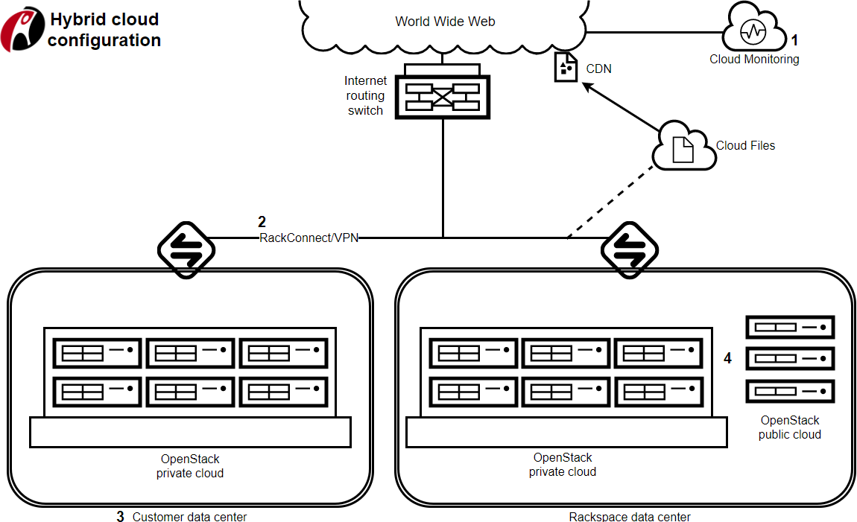
Hybrid Systems – 2012
https://support.rackspace.com/how-to/rackspace-open-cloud-reference-architecture/

Slide 41
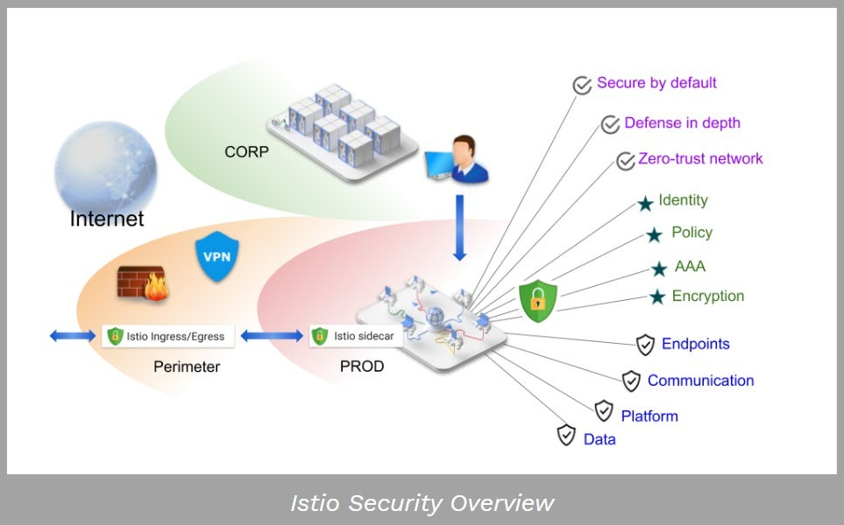
Service Meshes - 2019
https://support.rackspace.com/how-to/rackspace-open-cloud-reference-architecture/
Notes:
Modern applications are typically architected as distributed collections of microservices, with each collection of microservices performing some discrete business function.
A service mesh is a dedicated infrastructure layer that you can add to your applications.
It allows you to transparently add capabilities like observability, traffic management, and security, without adding them to your own code.
term “service mesh” describes both the type of software you use to implement this pattern, and the security or network domain that is created when you use that software.

Slide 42
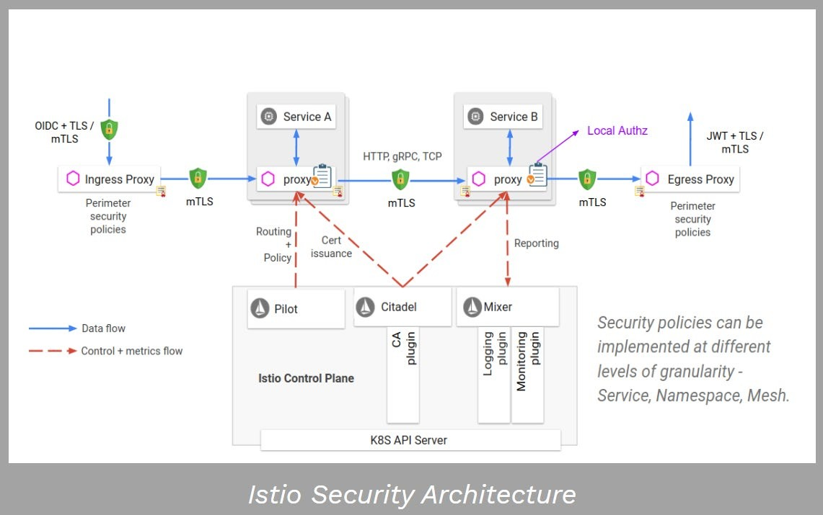
Service Meshes - 2019
https://support.rackspace.com/how-to/rackspace-open-cloud-reference-architecture/
Notes:
Istio is an open source service mesh, it has two components: the data plane and the control plane.
- The data plane is the communication between services. Without a service mesh, the network doesn’t understand the traffic being sent over, and can’t make any decisions based on what type of traffic it is, or who it is from or to.
- Service mesh uses a proxy to intercept all your network traffic, allowing a broad set of application-aware features based on configuration you set.
- An Envoy proxy is deployed along with each service that you start in your cluster, or runs alongside services running on VMs.
- The control plane takes your desired configuration, and its view of the services, and dynamically programs the proxy servers, updating them as the rules or the environment changes.

Slide 43
Third Party Software and Services
Patching and vulnerability management is often an afterthought when it comes to stay up to date with third party software.
Looking for unpatched systems is an easy way to gain privileged way to server systems.

Slide 44
Processes in an Enterprise Network
Bigger organizations have more processes on their managed devices
Attackers might take advantage of this to blend in with the noise
Use them to stay under the radar

Slide 45
The Human Factor in Enterprise Networks
Adversaries know that one of the weakest links in an enterprise is the human factor
Social Engineering attacks - provide one of the most straight forward ways for an adversary to gain a foothold in an enterprise
Phishing Attacks are very common attack angle – check your Spam folder!
Tailgating
Lockpicking

Slide 46
Red Teaming
During your professional career you might be involved in an enterprise network cyber operational red teaming.
Simulate a real-world adversary and measure the company’s ability to detect an adversary
Walmart Red Team at BlueHat 2018: “If we win, we lose”- https://youtu.be/ifCeaYShRSU
How to measure success: https://wardolphin.party/2020/01/24/Forecasting-risks- inside-an-organisation.html
Lots of opinions on how to do Red/Blue teaming best
The value of red teaming: inform company on how to prioritize their security investments by demonstrating the business impact of a breach

Slide 47
Thanks!

